Slide 1

PREDICTIVE ANALYTICS FOR RETAIL
PP
BANKING
Submitted By:
Gopinath V
Praveeenraj S
Prem Sai Bhyri
Sahana R

Slide 2
Abstract:
Today banks are facing intensive competition due to the gradual growth of many banks as well as due to the increase in demands of the customers.
To trap these needs of the customers, many banking institutions are using predictive analytics.
Hence here in this project we are using Machine Learning’s Random Forest Regression algorithm to predict whether the customer will subscribe the term deposit or not.

Slide 3
Introduction:
Predictive analytics is the process of using computer models to predict future events.
Sophisticated programs rely on artificial intelligence, data mining, and machine learning to analyze enormous amounts of information.
With those resources, the model attempts to determine what is likely to happen next, given current conditions.

Slide 4
Existing Problem:
In retail banking , there are many challenges some of them are:
Increasing competition
A single view of customer
Innovation
Cost Reduction
Improving the Customer Experience
Employee Engagement and Retention
Acting Fast

Slide 5
Proposed solution:
Retail banking customer segmentation is a key to retain customers. Similarly, it can help in drive up their lifetime value (LTV).
Lifecycle marketing can help you create engaging conversations in every stage of their journey.
By segmenting customers this way, you can apply a marketing strategy that communicates the right message at the right time.
For instance, running a data model can help you predict which customers are most likely to churn.
Predicting by manual methods takes more time, So, we have used Machine Learning Technique to predict.

Slide 6
Basic Process:
Data collection:
Dataset for predictive analysis is collected from kaggle.
Data preprocessing:
It is the process of inspecting, cleaning, transforming, and modeling data.
Model Training:
Random Forest Regression algorithm is used for Model training.
Flask:
It is used for deployment.

Slide 7
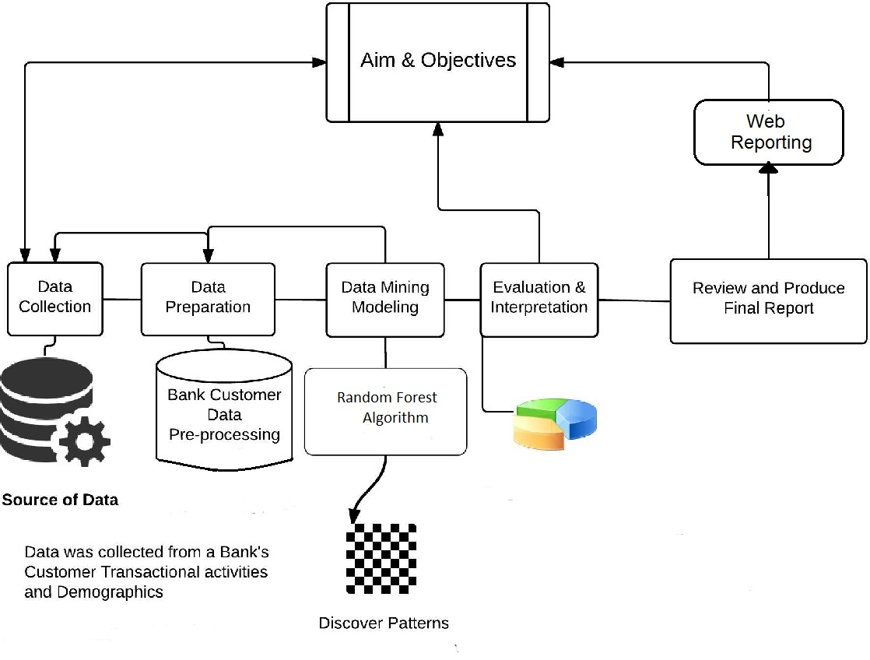
FLOW CHART:

Slide 8
Result:
We got an accuracy of 0.81which is a good measure for Random Forest Regression.
The model predicts with good efficiency.

Slide 9
Advantages & Disadvantages:
Advantages:
Predictive Analysis techniques can provide managers and executives with decision-making tools to influence up selling sales and revenue forecasting, manufacturing optimization, and even new product development.
Disadvantages:
Time also plays a role in how well these techniques work. Though a model may be successful at one point in time, customer behaviour changes with time and therefore a model must be updated.

Slide 10
Future Scope:
Banking industry has incorporated the traits that were once limited just to segment like data and analytics.
Data is seen as the most valuable asset to successfully stabilise the overall evolving banking environment.
Better personalization with rich data
The growth prospect of open banking
Digital-only Banking
Payments Infrastructure
Incorporation of Advanced Analytics

Slide 11
THANK YOU

